Slide 1
Neural Networks
Definition, Activation Functions, Overfitting & Drop Out

Slide 2
Introduction
In this chapter, we are going to talk about neural networks, one of the most powerful and versatile machine learning techniques.
These models are designed to mimic the way the human brain processes information, allowing computers to learn patterns, recognize complex relationships, and make accurate predictions.
We will explore the fundamental components of neural networks, including activation functions, network structures, and multilayer architectures.

Slide 3
Introduction
By the end of this course, you'll be able to:
Understand the fundamental principles of neural networks and how they mimic the human brain to process information.
Explain the role of activation functions and how they impact learning in neural networks.
Build and train neural networks using Python and TensorFlow for various machine learning tasks.
Implement different network architectures, including multilayer perceptrons (MLPs) and convolutional neural networks (CNNs).
Develop models for real-world applications, including image classification, optical character recognition (OCR), and predictive analytics.

Slide 4
01
Definitions

Slide 5
Definition
Neural networks are a class of machine learning models designed to simulate the way the human brain processes information.
They consist of layers of artificial neurons that process input data, learn patterns, and make predictions.
These networks are widely used in applications such as image recognition, natural language processing, and autonomous systems.

Slide 6
Why Neural Networks Are Better Than Other Techniques
Feature Learning: Unlike traditional machine learning models that require manual feature engineering, neural networks automatically extract important features from raw data.
Non-linearity: Activation functions enable neural networks to learn complex, non-linear relationships in data, which linear models cannot handle.
Scalability: Neural networks can process large amounts of data efficiently, making them suitable for large-scale tasks.
Generalization: When trained properly with regularization techniques, neural networks can make accurate predictions on unseen data by capturing essential patterns.

Slide 7
Activation Functions
Activation functions are mathematical functions applied to the output of each neuron in a neural network to introduce non-linearity. This allows the network to learn complex patterns and relationships in data. Without activation functions, a neural network would behave like a simple linear model, limiting its ability to solve complex problems.
HTTP clients use different HTTP methods to request for resources from the server
GET: used to retrieve data from the server
POST: submit data to be processed by the server, used for resource creation
PUT: Update/add a resource to the server
DELETE: remove data from the server
PATCH: apply partial modifications to a resource.

Slide 8
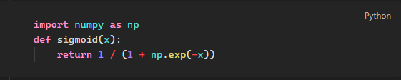
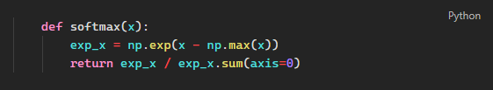
Types of Activation Functions
For Classification :
Sigmoid Function: Outputs values between 0 and 1, making it suitable for binary classification problems.
Softmax Function: Used for multi-class classification, producing probabilities for each class.

Slide 9


Types of Activation Functions
For Regression :
ReLU (Rectified Linear Unit): Outputs max(0, x), which helps prevent vanishing gradients and improves learning efficiency.
Leaky ReLU: Addresses the issue of zero gradients in standard ReLU by allowing small gradients for negative values.

Slide 10
Network Structures

Slide 11
Components of a Neural Network
Input Layer : Receives raw input data.
Hidden Layers : Process inputs through weighted connections and activation functions.
Output Layer: Produces final predictions based on learned representations.-
Weights & Biases : Parameters that adjust during training to minimize error.

Slide 12
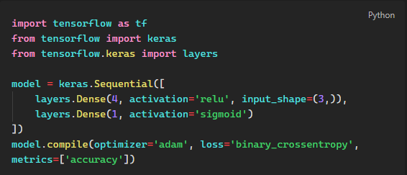
Components of a Neural Network

Slide 13
Multilayer Neural Networks
Depiction of a Multilayer Network

Slide 14
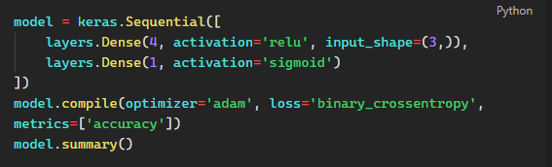
Multilayer Neural Networks
Python Code for Multilayer Perceptron

Slide 15
Overfitting and Dropout
Overfitting occurs when a neural network learns patterns specific to the training data, including noise, rather than generalizing well to new, unseen data.
This results in high accuracy on training data but poor performance on validation data.

Slide 16
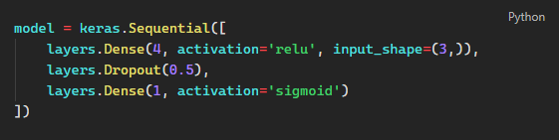
Overfitting and Dropout
Solution: Dropout
Dropout is a regularization technique that randomly deactivates a percentage of neurons during training, preventing the model from relying too much on specific features.
Python Code with Dropout:

Slide 17
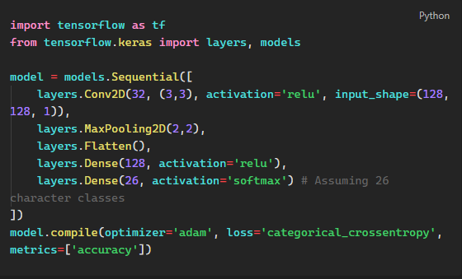
TensorFlow Code for OCR
Optical Character Recognition (OCR) using TensorFlow involves using convolutional neural networks (CNNs) to process and recognize text in images.
Python Code for OCR with TensorFlow:

Slide 18

Computer Vision
Convolution
Convolution is the process of applying a filter (kernel) to an image to extract important features like edges, shapes, and textures.
Max Pooling
Max pooling is a downsampling operation that reduces the size of feature maps while preserving key information. It helps in reducing computational complexity and preventing overfitting.
Python Code for Max Pooling:

Slide 19
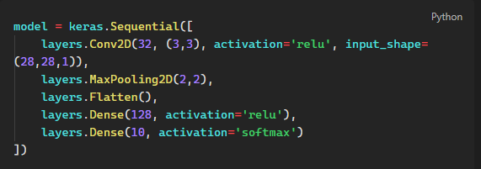
Computer Vision

Slide 20


